Slide 1

The Machine Learning Process
How do I read a tabular data file
into pandas?
Reza Dibaj

Slide 2
What is tabular data?
Tabular data: the data that looks like a table (rows and columns)
e.g. an Excel spreadsheet
Common format → Comma-separated value (CSV)

Slide 3
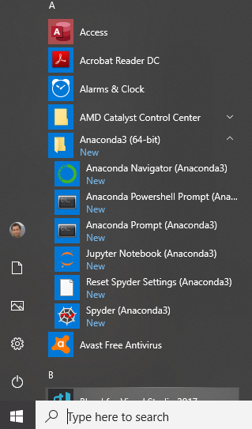
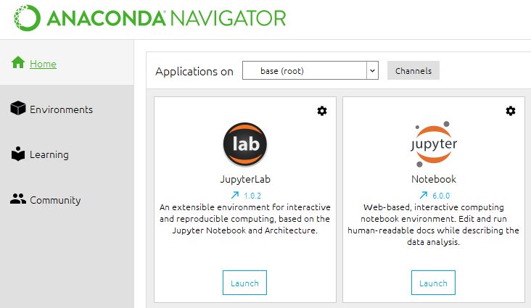
Let’s start pandas, using the jupyter Notebook (1st Method)
1
2

Slide 4
Let’s start pandas, using the jupyter Notebook (2nd Method)

Slide 5
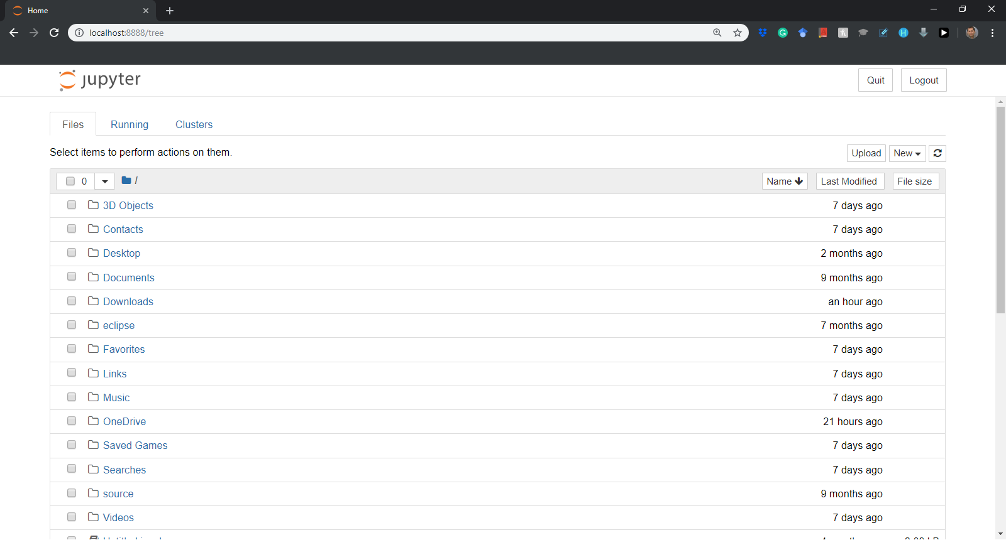
Welcome to jupyter….

Slide 6
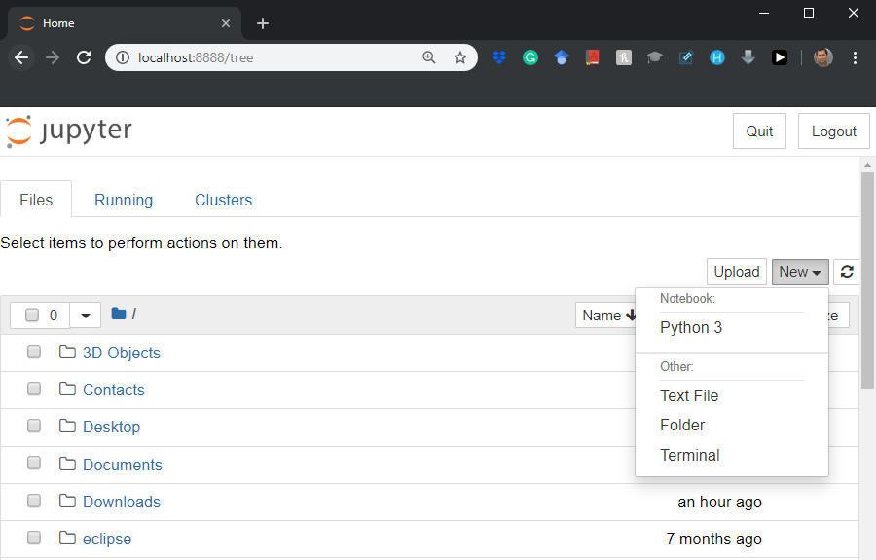
Welcome to jupyter….
Let’s create a new Python 3 project….

Slide 7
Question for Reza…
Q: Reza! I do not want to create my Python project in the default location. How can I change the path?
R: You need to go to Anaconda Prompt, and then to the path that you like to create your project; e.g.
D:\Machine Learning\My Jupyter Files
Then simply type jupyter notebook and press the Enter key.
Notes:
jupyter notebook

Slide 8
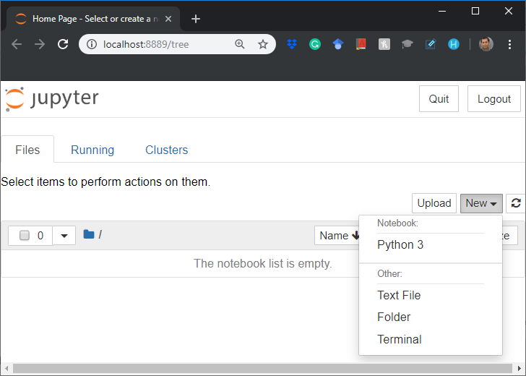
Welcome to jupyter….
Let’s create a new Python 3 project….

Slide 9
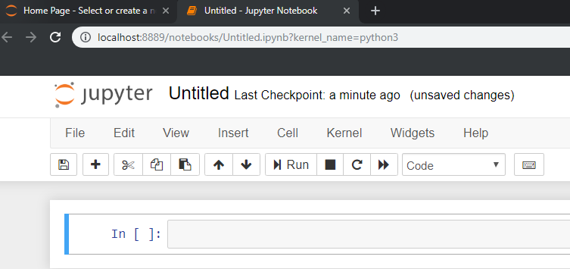
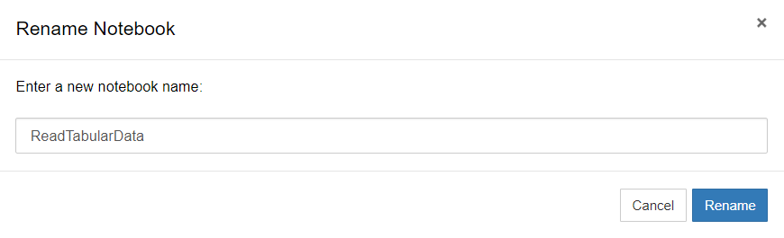
Welcome to jupyter….
Let’s rename the title….
Notes:
ReadTabularData

Slide 10
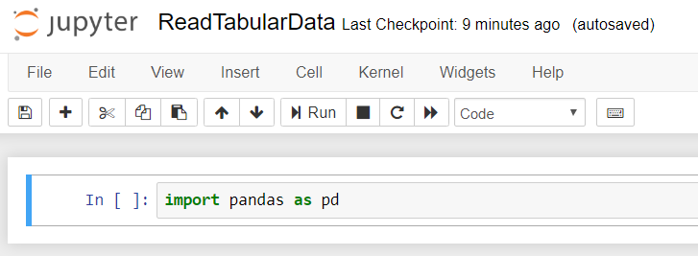
Importing pandas library….
We need to import the pandas library as follows….
We need to import the pandas library as follows….

Slide 11
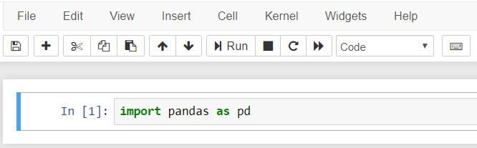
Importing pandas library….
Please run the code by pressing the Run button or Shift + Enter…
* Shows it is compiling and numbers show it is already compiled.
Notes:
import pandas as pd

Slide 12

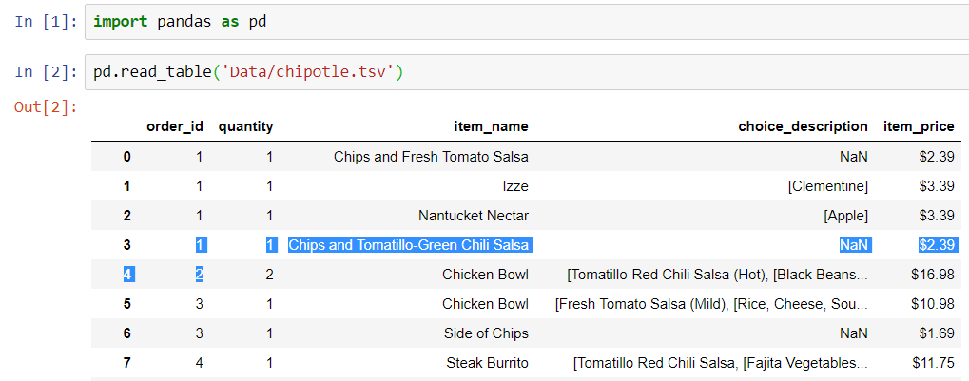
Using a sample dataset….
Let’s import the Chipotle restaurants orders’ dataset….
We need to use read_table function. There are other alternatives, such as read_svc that you can find in the note.
Notes:
import pandas as pd
pd.read_table('Data/chipotle.tsv’)
pd.read_table('http://bit.ly/chiporders')
pd.read_table('Data/chipotle.tsv', sep='\t’)
pd.read_table('http://bit.ly/chiporders', sep='\t’)
pd.read_csv('Data/chipotle.tsv', sep='\t', lineterminator='\n')

Slide 13

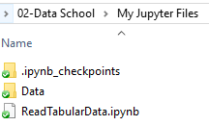

What if I do not have the dataset?
You can use the following link to access to the Chipotle dataset and save the content in a tsv file in your local drive and directory.
http://bit.ly/chiporders
In our example, we have saved in in Data folder in our project folder.
The other solution is to directly use the following URL to access to your dataset:
pd.read_table('http://bit.ly/chiporders')
Notes:
http://bit.ly/chiporders
pd.read_table('http://bit.ly/chiporders')

Slide 14
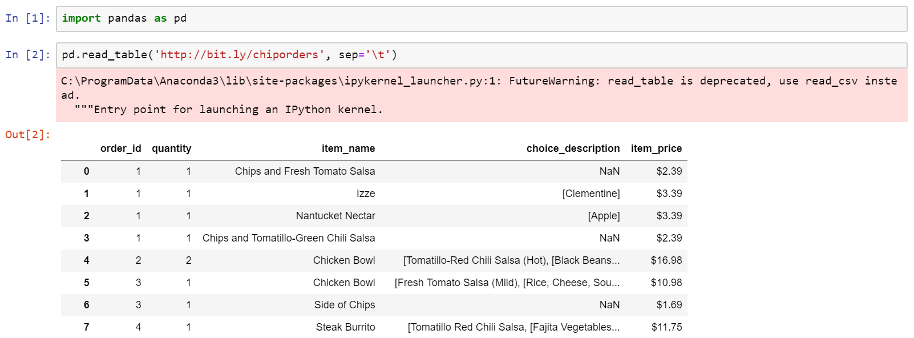
What if you receive the following warning?
It shows we have version problem and version incompatibility.

Slide 15
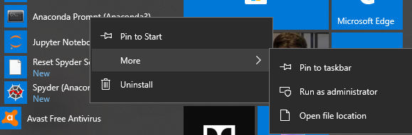
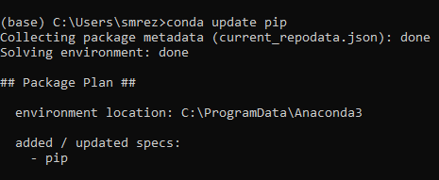
Version incompatibility
If you face any version incompatibility, please go to Anaconda Prompt (run it as admin) and type the following command:
conda update pip
Notes:
conda update pip

Slide 16

More about read_table
read_table by default considers that the file is tab-separated.
Moreover, it considers the first row as the column-header which was fine with our example.

Slide 17
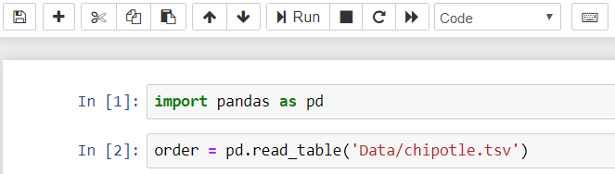
Saving the dataset in an object
We save the dataset as a DataFrame object as follows:
pandas DataFrame is the primary unit of data storage in the pandas library.
Notes:
A DataFrame is an immutable distributed collection of data.
Code:
orders = pd.read_table('Data/chipotle.tsv')

Slide 18
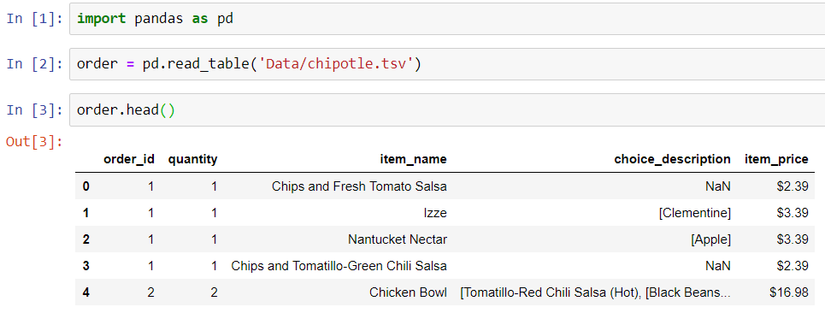
Saving the dataset in an object
Listing the top 5 rows of the dataset as follows:
Notes:
import pandas as pd
order = pd.read_table('Data/chipotle.tsv’)
order.head()

Slide 19
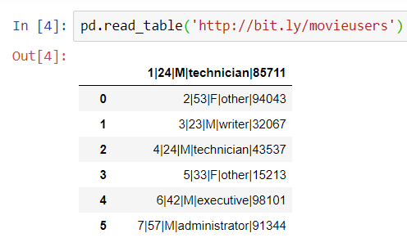
Another example… but?!?
Let’s fetch the dataset from the following URL:
http://bit.ly/movieusers
Clearly, something is wrong.
Notes:
import pandas as pd
order = pd.read_table('Data/chipotle.tsv’)
order.head()
pd.read_table('http://bit.ly/movieusers')

Slide 20

Group Discussion
How should we fix this issue?

Slide 21
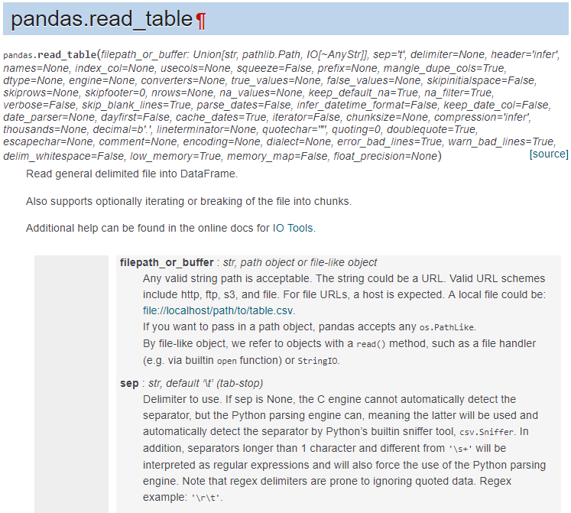
Group Discussion
One method could be googling…
Notes:
https://pandas.pydata.org/pandas-docs/stable/reference/api/pandas.read_table.html

Slide 22
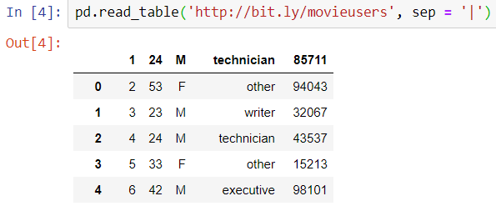
The solution is this…
We need to define the separator.
Notes:
pd.read_table('http://bit.ly/movieusers', sep = '|')

Slide 23

But… Hold on a sec… What?!?
Look at the first row… Obviously it should not be the column headers.
Notes:
pd.read_table('http://bit.ly/movieusers', sep = '|')

Slide 24

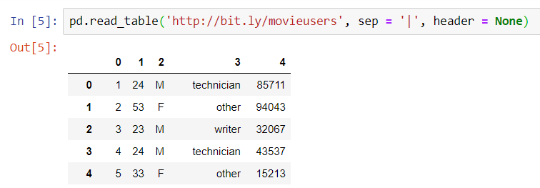
The solution is this…
We need to say that we have no header though… But the default column headers are not very appropriate, eh?
Notes:
pd.read_table('http://bit.ly/movieusers', sep = '|', header = None)

Slide 25
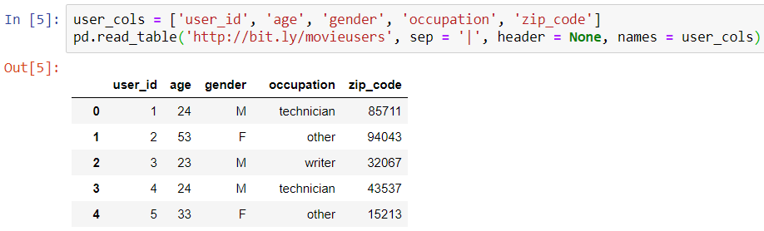
Defining column headers
So we define column headers using a variable
user_cols = ['user_id', 'age', 'gender', 'occupation', 'zip_code’]
And pass it to a read_table names argument as follows:
Notes:
user_cols = ['user_id', 'age', 'gender', 'occupation', 'zip_code']
pd.read_table('http://bit.ly/movieusers', sep = '|', header = None, names = user_cols)

Slide 26
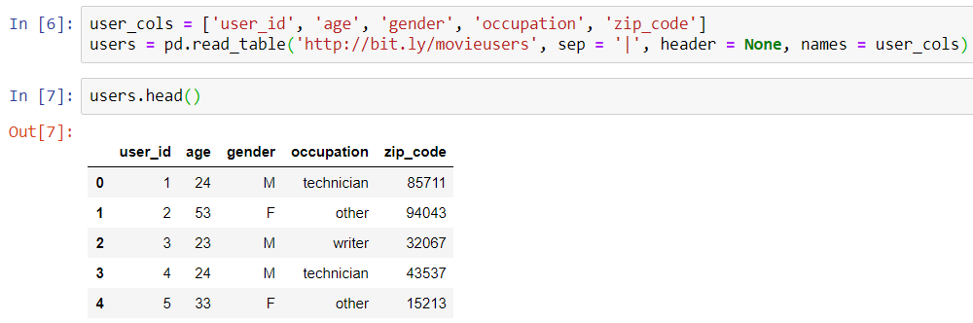

Looks PERFECT! Eh?
We save it as a DataFrame object, like before and now it is ready to use.
Next, we fetch its top 5 row.
Notes:
user_cols = ['user_id', 'age', 'gender', 'occupation', 'zip_code']
users = pd.read_table('http://bit.ly/movieusers', sep = '|', header = None, names = user_cols)
users.head()

Slide 27

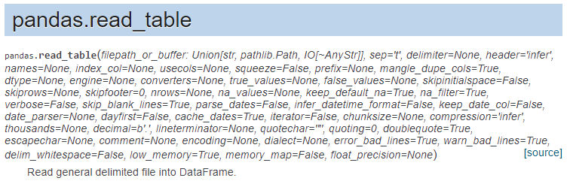
Bonus Tip
Two read_table useful arguments: skiprows and skipfooter
skiprows → to skip the comments or notes on top of the file that is not a part of actual dataset
skipfooter → to skip the comments or notes at the bottom of the file that is not a part of actual dataset

Slide 28

Thank you
Question?
To be
Not to be

